Slide 1
Learning by Correcting Mistakes

Slide 2
Metacognition
Learning by Correcting Mistakes
Meta-Reasoning
Ethics in Artificial Intelligence

Slide 3
Lesson Preview
Explanation-based learning revisited
Isolating mistakes
Explaining mistakes
Correcting mistakes

Slide 4
A Cup
A cup is an object that is stable and enables drinking.
An Object
This object is light and made of porcelain. It has a decoration, a concavity, and a handle. The bottom is flat.
Can we prove this object is a cup?

Slide 5
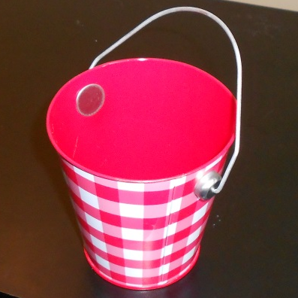
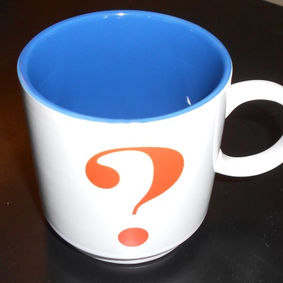
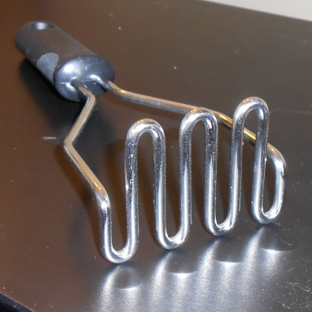
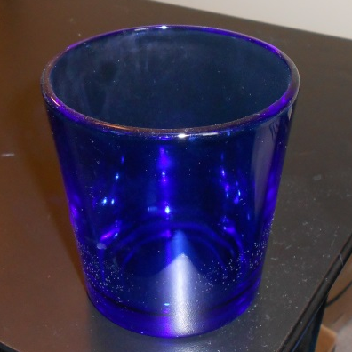
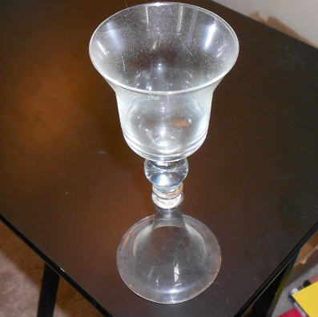
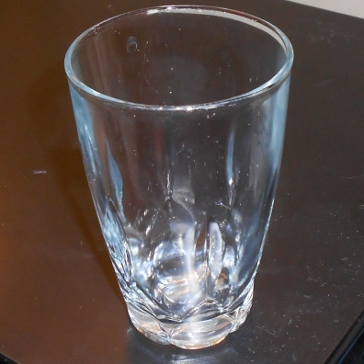
Which of these objects are cups? Check the box in the top left for each cup.
Which of these objects meet our definition of a cup? Check the box in the top right for each object that meets our definition.
ο ο
ο ο
ο ο
ο ο
ο ο
ο ο

Slide 6

A Cup
A cup is an object that is stable and enables drinking.
An Object
This object is light and made of porcelain. It has a decoration, a concavity, and a handle. The bottom is flat.
Can we prove this object is a cup?

Slide 7
Questions for Learning from Mistakes
1. How can the agent isolate the error in its former model?
2. How can the agent explain the problem that led to the error?
3. How can the agent repair the model to prevent the error from recurring?

Slide 8



Slide 9
handle-
fixed
handle-
moves

Slide 10
Algorithm for Isolating Mistakes
To find suspicious true-success relations:
Intersect all true successes (∩T)
Union all false successes (∪F)
Remove assertions in union from intersection (∩T - ∪F)
To find suspicious false-success relations:
Intersect all false successes (∩F)
Union all true successes (∪T)
Remove all assertions in union from intersection (∩F - ∪T)

Slide 11
Old Rule
If:
Object has bottom
Bottom is flat
Object has concavity
Object is lightweight
Object has a handle
Then:
Object is a cup
New Rule
If:
Object has bottom
Bottom is flat
Object has concavity
Object is lightweight
Object has a handle
Handle is fixed
Then:
Object is a cup

Slide 12
Current Concept
Not an Arch
New Concept
Brick
Brick
Brick
must- support
must- support
must- support
must- support
supports
supports
Brick
Brick
Brick
Brick
Brick
Brick
left-of
left-of
left-of
touches
¬touches
touches
¬touches

Slide 13
Questions for Learning from Mistakes
1. How can the agent isolate the error in its former model?
2. How can the agent explain the problem that led to the error?
3. How can the agent repair the model to prevent the error from recurring?

Slide 14
is
Object
Cup
is
enables
Object
Stable
Object
Drinking
has
Object
Bottom
is
Bottom
Flat
carries
Liquids
is
Object
Object
Liftable
made-of
Object
Porcelain
has
is
has
Object
Concavity
Object
Light
Object
Decoration
has
Object
Handle

Slide 15
is
Object
Cup
is
enables
Object
Stable
Object
Drinking
has
Object
Bottom
is
Bottom
Flat
carries
Liquids
is
Object
Object
Liftable
made-of
Object
Porcelain
has
is
has
Object
Concavity
Object
Light
Object
Decoration
has
Object
Handle

Slide 16
is
Object
Cup
enables
Object
Drinking
carries
Liquids
is
Object
Object
Liftable
has
is
Object
Concavity
Object
Light
is
has
Handle
Fixed
Object
Handle

Slide 17
Is this a good way to fix this error?
ο Yes, because it shows only fixed-handle cups enable drinking.
ο No, because it will exclude some actual cups.
ο No, because some non-cups will still be included.
ο No, because it will cause incorrect decisions about other objects.
is
Object
Cup
enables
Object
Drinking
carries
Liquids
is
Object
Object
Liftable
has
is
Object
Concavity
Object
Light
is
has
Handle
Fixed
Object
Handle

Slide 18
is
Object
Cup
enables
Object
Drinking
carries
Liquids
is
Object
is
Object
Liftable
Handle
Fixed
has
is
Object
Concavity
Object
Light
has
Object
Handle

Slide 19
is
Object
Cup
enables
Object
Drinking
is
Object
Manipulable
carries
Liquids
is
Object
Object
Liftable
has
is
is
Object
Concavity
Handle
Fixed
Object
Light
has
Object
Handle

Slide 20
is
Object
Cup
enables
Object
Drinking
is
Object
Manipulable
is
Object
Orientable
carries
Liquids
is
Object
Object
Liftable
has
is
Object
Concavity
Object
Light
is
Handle
Fixed
has
Object
Handle

Slide 21
Current Concept
Not an Arch
New Concept
Brick
Brick
Brick
must- support
must- support
must- support
must- support
supports
supports
Brick
Brick
Brick
Brick
Brick
Brick
left-of
left-of
left-of
touches
¬touches
touches
¬touches

Slide 22
Assignment
How would you use diagnosis to design an agent that could answer Raven’s progressive matrices?

Slide 23
To recap…
Explanation-based learning and incremental concept learning revisited
Isolating mistakes
Explaining mistakes
Correcting mistakes

